Slide 1
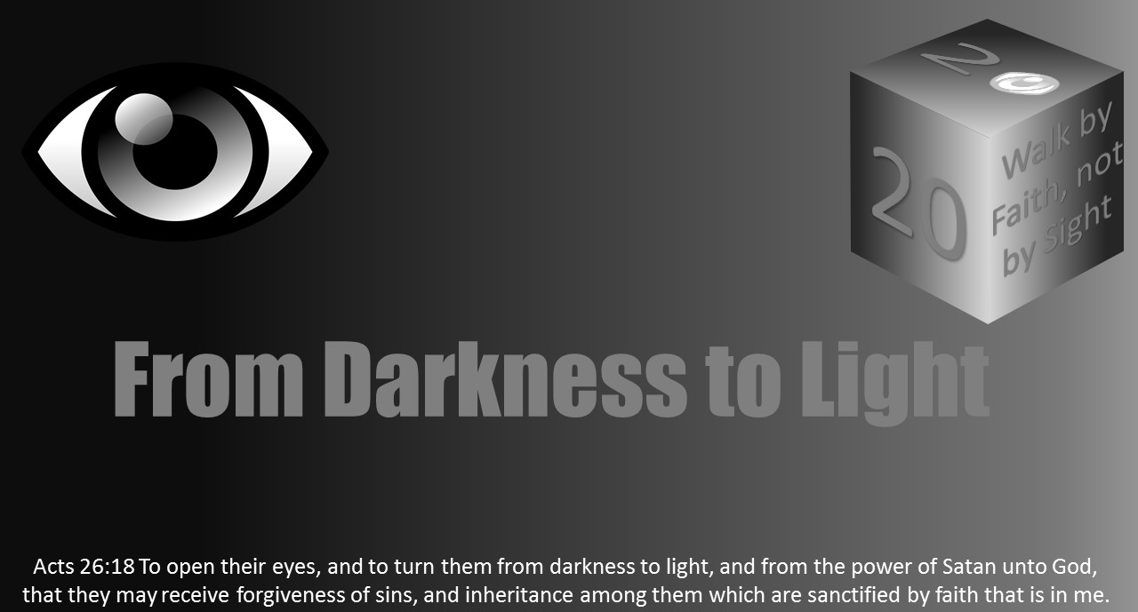


Slide 2
Light Lesson 3 From Darkness to Light

Slide 3
2 Corinthians 4:3-6: Who is responsible for the darkness and the light existing in the world? Which extreme dominates the world?
But if our gospel be hid, it is hid to them that are lost: 4 In whom the god of this world hath blinded the minds of them which believe not, lest the light of the glorious gospel of Christ, who is the image of God, should shine unto them. 5 For we preach not ourselves, but Christ Jesus the Lord; and ourselves your servants for Jesus' sake. 6 For God, who commanded the light to shine out of darkness, hath shined in our hearts, to give the light of the knowledge of the glory of God in the face of Jesus Christ.
Introduction

Slide 4
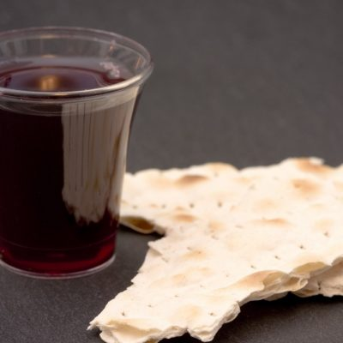
“Sunrise service” -- “Christ the Lord is Risen.”
Although there is no clarification of this special Sunday having a primary emphasis in scripture, the day of Jesus’ resurrection is symbolic of “the Light” (Jesus) raised back into the world.
To the contrary of emphasizing this special “sunrise service,” Christians are to remember each first day of the week the Lord’s resurrection to light from the darkness of the grave.
Introduction

Slide 5
The few days before Jesus’ resurrection needs our attention at the moment.
Three gospels (Matthew, Mark, and Luke) present a day of darkness literally so (Matt 27:45).
What was God saying in this darkness?
It is not, “Christ is Risen!!”.
“He is dying” on the cross that day, which means it was getting dark.
The light is going out, which is how we refer to the death of anyone.
It is a darkness, but what is the meaning of the darkness.
Introduction

Slide 6
The Light of Life was Going Out
Jesus was dying. He was losing life, and the light of the world was going out.
His death was terminal and would not be stopped.
A light which should have shined longer but went out sooner.
This “light” was outside, hanging on a cross, not in a hospital bed or at home as most people might be. He was in the public’s eye to show how much the darkness of sin and its power reigns.
As the SUN went out, the SON was going out as well.
Satan’s power had come to a hopeless, helpless world.
At that moment he was the winner.

Slide 7
The Purity and Perfection of Life was Dying
Before His death upon the cross, Jesus had spoken of leaving, and it troubled the apostles
John 14:1-3 Let not your heart be troubled: ye believe in God, believe also in me. 2 In my Father's house are many mansions: if it were not so, I would have told you. I go to prepare a place for you. 3 And if I go and prepare a place for you, I will come again, and receive you unto myself; that where I am, there ye may be also.
Why did Jesus leaving bother His apostles?

Slide 8
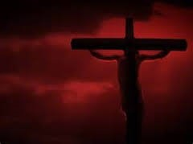
The Purity and Perfection of Life was Dying
Jesus leaving was not only darkness. He was made to be sin and its darkness, corruption, and disease with all its impurities and ugliness (2 Cor 5:21).
All of this was taking over the innocent Christ. Jesus was being paid the wages of sin - death.
We may think it is bad in this world with its corruption and say “it is a dark world we live in.”
Think about all that sin taking over the Christ in the darkness of His death.
There is one reality in the dark death of Jesus. My sin brought the darkness of death to Jesus that day. The darkness of my sin took away the “light.”

Slide 9
God’s Favor of Jesus is Removed
God’s justice toward His displeasure of sin in the world was manifest the day of Jesus’ death.
God’s love for man sought to remove the darkness of sin.
God delighted in Jesus being the one upon whom that darkness would rest.
Most would believe this is where God would rescue Jesus from suffering a painful death.
Those crucifying Him referred to God and said, “let him deliver him now, if he desireth him…” (Matt 27:43).
God took His favor away and allowed Jesus to die (Matt 27:46).
God “forsakes” the sin which Jesus bore.

Slide 10
God’s Favor of Jesus is Removed
All of these points of death which came upon Jesus should call upon us to have an attitude of disgust and anger toward sin.
No man should “buddy up” next to the darkness of sin.
No man should “lighten up” on the proclamation of sin’s devices and destructions. Sin has been and always will be a serious, darkening problem.
In the midst of the dark moments of Jesus’ death, what does 2 Corinthians 4:6 says happened?

Slide 11
To See the Light, You have to Deal with the Darkness
What is the powerful transformation described in Colossians 1:12-14?
12 Giving thanks unto the Father, which hath made us meet to be partakers of the inheritance of the saints in light: 13 Who hath delivered us from the power of darkness, and hath translated us into the kingdom of his dear Son: 14 In whom we have redemption through his blood, even the forgiveness of sins:
Who made such a powerful transformation possible?

Slide 12
To See the Light, You have to Deal with the Darkness
Before being a Christian, each person must deal with the darkness. A person has to see its disappointment.
Notice the darkness of your life, then come to the light of salvation (John 14:6).
Come to understand those saved by faith in Christ are not merely improved, they are radically transformed from darkness to light.
The conditions are opposite from darkness, totally. We are delivered from death, given eternal life, and saved from the grave of sin to a new life (2 Cor 5:17) in the light which is characterized by good works (Eph 2:9,10) to become sons of the living God children of light (John 1:12; Eph 5:8).

Slide 13
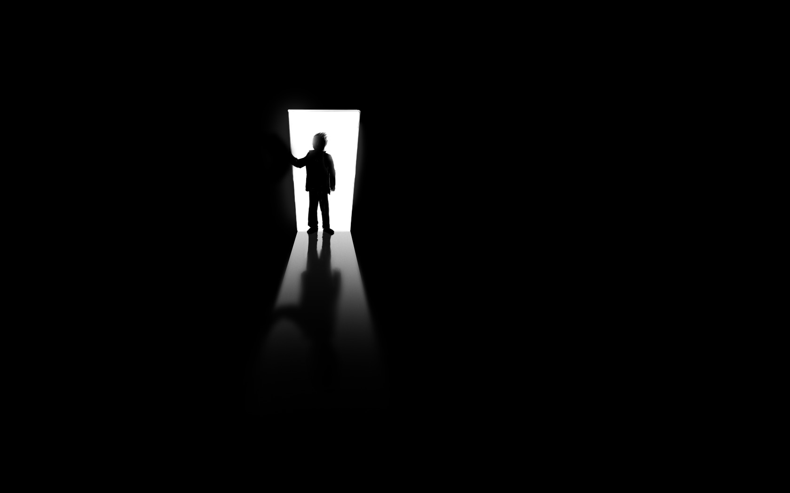
To See the Light, You have to Deal with the Darkness
This change in our condition should be followed by a corresponding change in our conduct.
How does Ephesians 4:1 describe the walk of a Christian?
What further indications of a Christian’s walk in the light are found in Ephesians 4:2-16?
In Ephesians 4:17-32, how different is the walk in the light versus the walk in the darkness?

Slide 14
To See the Light, You have to Deal with the Darkness
How we deal with darkness is not to adopt the popular perception of Christianity often presented as though faith in Jesus Christ requires no great change.
Some present Christianity as just “adding” Christ to your life experience.
“Invite Christ into your life” like you would a friend or family member.
You know they will not stay long.
It will be a pleasant, short time with minimal inconvenience.

Slide 15
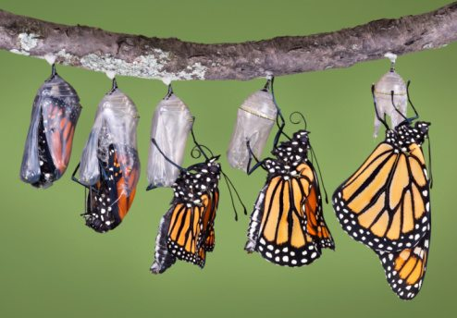
To See the Light, You have to Deal with the Darkness
Whenever a Christian trusts God in the change from darkness to light, it is not small or a few things which need adjusting.
It is radical transformation.
The same was true with Jesus coming from the grave.
It was death to life, darkness to light.
Our life in the light is abandoning darkness to live in the light - Jesus Christ.

Slide 16
To See the Light, You have to Deal with the Darkness
When Jesus spoke of being a disciple, He cautioned those who would do so quickly to “count the cost”.
In reading Luke 9:23-24, 57-62, what cost is there to being a disciple and walk in the light?
Luke 9:23-24 And he said to them all, If any man will come after me, let him deny himself, and take up his cross daily, and follow me.24 For whosoever will save his life shall lose it: but whosoever will lose his life for my sake, the same shall save it.
Luke 9:57-62 And it came to pass, that, as they went in the way, a certain man said unto him, Lord, I will follow thee whithersoever thou goest. 58 And Jesus said unto him, Foxes have holes, and birds of the air have nests; but the Son of man hath not where to lay his head. 59 And he said unto another, Follow me. But he said, Lord, suffer me first to go and bury my father. 60 Jesus said unto him, Let the dead bury their dead: but go thou and preach the kingdom of God. 61 And another also said, Lord, I will follow thee; but let me first go bid them farewell, which are at home at my house. 62 And Jesus said unto him, No man, having put his hand to the plough, and looking back, is fit for the kingdom of God.

Slide 17
To See the Light, You have to Deal with the Darkness
Living in the light is not when I feel like it or when I do not, when it inspires me or not, or when I want to or not.
To remove such a lazy approach, Jesus calls our attention to the words of Ephesians 5:14: “Wherefore he saith, “Awake, thou that sleepest, and arise from the dead, and Christ shall shine upon thee.”
This statement comes from Isaiah 60:1-3, describing light and darkness. The admonition in that passage is to be light among the nations.
Isaiah spoke to this theme of light and darkness in one particular case pointing out how some confuse the two in Isaiah 5:20, “Woe to those who call evil good, and good evil; Who substitute darkness for light and light for darkness.”
In Isaiah 42:6, 7, 16, the prophet exalts God by how He will bring those in darkness to light (Isaiah 50:10; 51:4).

Slide 18
To See the Light, You have to Deal with the Darkness
The theme of bringing people from darkness to light continues in the New Testament.
In the gospels, at the beginning the “Light” came into the world, Jesus Christ (Luke 2:25-32, John 1:4-9).
Jesus spoke of himself as the light (John 8:12; 12:46) and spoke of those who followed him as light (Matt 5:14; John 12:35, 36).
Then in the book of Acts and the epistles, the theme continues.
As the writer of many of those epistles, Paul’s conversion is an example which came from literally being in darkness, not able to see, to seeing when the message of light was taught to him (Acts 9:8-18).
He spoke or wrote about light and darkness in Acts 13:47; Rom 13:11-14; 2 Cor 4:3-6; 6:14-18; 11:13-15; Col 1:9-14; 1 Thess 5:1-11.

Slide 19
To See the Light, You have to Deal with the Darkness
A fellow apostle, Peter spoke of all Christians being “called out of darkness into His marvelous light” (1 Pet 2:9,10).
John also says we should walk in the light to have fellowship with God & other brethren (1 John 1:5-10).
All of these passages indicates how God in His infinite wisdom shows man how to deal with darkness by coming to Him and reflecting in our life His light.

Slide 20
What Does Living as Lights Rather than Darkness Mean?
What does light do for a tree or plant?
It brings growth. Light produces fruit. What does Ephesians 5:9-11 say is produced by the light?
**Note in the passage the contrast of what fruit the light brings versus the “unfruitful works” from darkness.
Eph 5:9-11 (For the fruit of the Spirit is in all goodness and righteousness and truth;) 10 Proving what is acceptable unto the Lord.11 And have no fellowship with the unfruitful works of darkness, but rather reprove them.

Slide 21

What Does Living as Lights Rather than Darkness Mean?
Every Christian is commanded to desire light.
We are not to merely avoid the thoughts and deeds of darkness but to do what is right and fruitful to please the One who delivered us from darkness to light.
The closer and longer our association with the light motivates us to avoid all forms of darkness. We will say, “I don’t need to do that,” “that’s wrong,” “I can’t look like that, say those words, or believe that any longer.”
Yet, we need not place so much emphasis on the negative, avoidance, or what is prohibited (v.3, not even be named among you as becometh saints). If so, we may fail to see the value of the light, where we should live and the fruit we can bear.

Slide 22
What Does Living as Lights Rather than Darkness Mean?
Luke 11:33-36 No man, when he hath lighted a candle, putteth it in a secret place, neither under a bushel, but on a candlestick, that they which come in may see the light. 34 The light of the body is the eye: therefore when thine eye is single, thy whole body also is full of light; but when thine eye is evil, thy body also is full of darkness.35 Take heed therefore that the light which is in thee be not darkness. ³⁶If thy whole body therefore be full of light, having no part dark, the whole shall be full of light, as when the bright shining of a candle doth give thee light.

Slide 23
What Does Living as Lights Rather than Darkness Mean?
Living in the light is not blending with the darkness. Light always exposes darkness. What being in the light means is living in a society where immoral values, ideas, and patterns are exposed. Light shines upon a world who is rethinking sexuality, church work, means of salvation, items of worship, etc.
Those who live in the light are being pressed to put out the light, put it down, and do not shine so bright. We need to examine who we are based upon what Jesus says in Luke 11:33-36.
What is the responsibility of a disciple in that passage?

Slide 24

What Does Living as Lights Rather than Darkness Mean?
We need to refuse to look into the world of darkness for help, answers, guidance, and hope.
Look at the kingdom of light. Draw the line between dark and light.
Protect the purity of the church by protecting the purity of your life.
Manifest the light.
Refuse to turn the light down low.
Talk about the light. Talk about what coming from the darkness to the light has brought to your life. Do not be afraid of it. Believe it. Live it.
Be blessed by the light…

